Slide 1
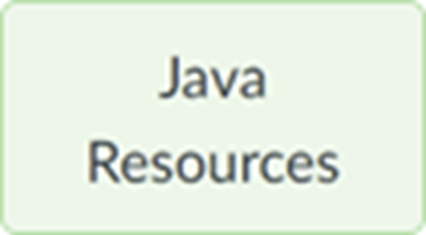
Section 10 (week of Nov 6): Event Handling part 3
We'll start at 5:01 (Tuesday) and 7:16 (Wednesday) Eastern Time.
Pset 4 & Term project proposal are due at start of the lecture 11 week at 9am. See the Notes and term project samples.
Important dates
Your questions
Demo illustrating Calculator’s required architecture
Additional Swing controls
Calculator JButton symbols
Arithmetic corner cases
State machine strategy for managing complexity
Zip file with this section’s slides and sample code is posted to course’s page

Slide 2
Important Dates
Nov 13 | Submit term project proposals Submit pset 4
Dec 4 | Submit pset 5
Dec 11 | Practice final posted
Dec 17 | Practice final review
Dec 18 | Submit pset 6 Submit term project
Dec 20 | Pset 6 late submission window closes at 9:00 AM Term project late submission window closes at 9:00 AM
Dec 20-21 | Final exam window
Jan 4 | Grades available at Online Services https://extension.harvard.edu/login/

Slide 3
Demo illustrating Calculator’s required architecture
Calculator.java
Creates a CalcBackend object
Lays out the JFrame
Adds action listeners for the JButtons. When actionPerformed runs, it:
Passes a char representing clicked button to CalcBackend’s feedChar(), and then immediately
Updates displayed String by calling CalcBackend’s getDisplayVal() to get new display String
CalcBackend.java
Constructor initializes calculator’s internal state
feedChar() updates calculator’s internal state, including updating the String that the GUI should display, in response to the char arg representing the latest click
getDisplayVal() just returns the String that the GUI should display
See PrimitiveTypewriter.java, PrimitiveTypewriterBackend.java

Slide 4
Additional Swing controls
JSlider
JTextArea
JFileChooser
See JSliderDemo.java, JTextAreaDemo.java, JFileChooserDemo.java

Slide 5
Calculator JButton Symbols
Unicode enables use of “fancy” button labels:
±
× (instead of *)
÷ (instead of /)
√
etc
See CalculatorSymbols.java

Slide 6
Calculator JButton Symbols
Please pay attention to the request in the sample CalcBackend.java:
// I would appreciate it if you would include comments like these (but with your // actual char values) in CalcBackend.java, because it will let me test your code // without investigating to see what character is passed to feedChar for the various // operators:
// CLEARCHAR = 'C',
// SQRTCHAR = '\u221A',
// MULTIPLICATIONCHAR = '*',
// DIVISIONCHAR = '/',
// ADDITIONCHAR = '+',
// SUBTRACTIONCHAR = '-';

Slide 7
Arithmetic Corner Cases
Do NOT manually check for things like divide by zero or trying to take the square root of a negative number.
You need not do anything special to properly handle those cases
CalcBackend does all of its calculations using the double data type
double supports special values with names like NaN (not a number), POSITIVE_INFINITY and NEGATIVE_INFINITY
Just do the calculation and update the double variable containing the result
See the sample code if you need to test for those special values
See ArithmeticCornerCases.java

Slide 8
State Machine
The biggest Calculator challenge is the requirement to produce reasonable and repeatable results for *any* button-click sequence.
Suggested approach (see hints):
Create a list of “states” that represent what the calculator is currently doing
Perhaps things like ready for first operand, ready for second operand, constructing operand (left of decimal point), constructing operand (right of decimal point), etc.
Create a list of button “categories”
Perhaps things like Digit, Decimal Point, Equals Sign, Binary Operator (+ - ÷ ×), Unary Operator (√)
When you pass a char to feedChar, then the backend can say “the calculator is in state x and the clicked button is in category y”
Now there are only x*y separate cases that the backend needs to support
See StateMachineUsingSwitches.java

Slide 9
State Machine
For example
// state = constructingOperandLeftOfDecimalPoint
// button category = DecimalPoint
public void constructingOperandLeftOfDecimalPointDecimalPoint {
this.state= constructingOperandRightOfDecimalPoint
}
// state = constructingOperandRightOfDecimalPoint
// button category = DecimalPoint
public void constructingOperandRightOfDecimalPointDecimalPoint {
// Do nothing; ignore the bogus decimal point click.
}

